Slide 1

Your Name – Your Business
7 Ways To Grow Your Business For FREE
LOGO

Slide 2
Contents
7 Ways To Increase Business:
Claim your business listing on the search engines
Implement a client review system
Completely fill out your profile on Yelp, Angie’s List, City Search and any other industry specific publications
Create a Facebook Places page
Create a Foursquare account for you business
Use video to communicate with prospects and clients
Create a YouTube Channel and post some “How To” videos

Slide 3
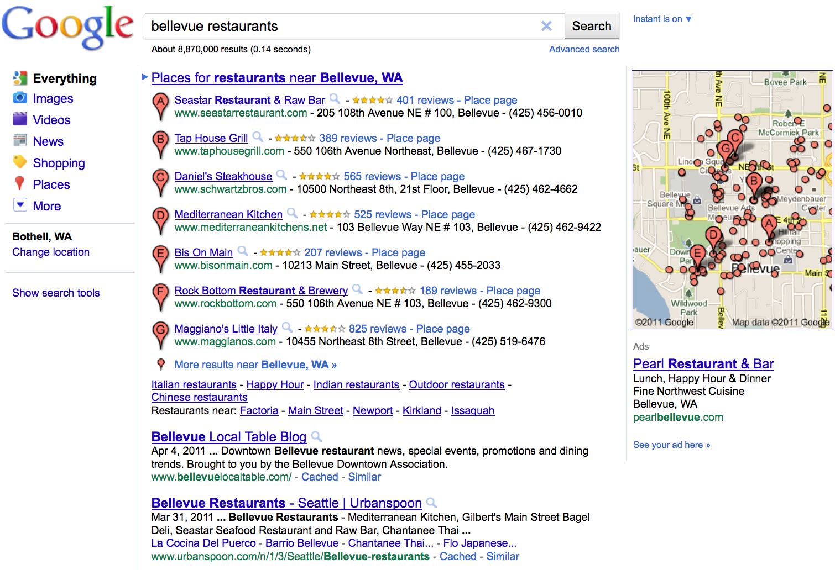
7 PROVEN STRATEGIES
Claim your business listing
Google made a few major changes to their algorithm in 2010 which drastically affected the way search results are displayed. They combined the business listings and organic search results. So now when Google predicts you are searching for a local business they will display the business listings above the organic search results. This small change gives local businesses a huge advantage over national companies. Your business will now be displayed above competitors without a local presences. It’s important for you to claim and completely fill out your business listing on Google, Yahoo and Bing. In order to be and remain on the first page; you need to have a strong online presence and continually maintain it.
Google: http://www.google.com/places
Yahoo: http://listings.local.yahoo.com/basic.php
Bing: https://ssl.bing.com/listings/ListingCenter.aspx
Business
listings
Organic
Results

Slide 4
7 PROVEN STRATEGIES
2. Implement Client Review System
78% of consumers trust Peer Recommendations more than anything else. Only 14% of consumers trust online advertisements.* When people are searching for your products and/or services they are reading the reviews about your company “good or bad” and making a buying decision based off those reviews. In fact, Google aggregates reviews from multiple sites across the internet and lists them on your Business Listing. You must implement a consistent review strategy in your business; in order to encourage “happy customers” to give you “positive” reviews. Google places a great deal of emphasis on how many reviews your business has when deciding where your listing is displayed. Customers with Smartphones can place a review for your business on Google right on the spot.
*Source, “Marketing to the Social Web”, Larry Weber Wiley Publishing 2007

Slide 5
7 PROVEN STRATEGIES
3. Complete Your Profile
With the evolution of Smartphones and applications people are starting to search for businesses inside of applications like Yelp and on review sites like Angie’s List. It is important for you as a business owner to completely fill out your business profile on these types of sites. You should also seek industry specific sites where you can list your business. These sites are a great resource for FREE traffic.
Some Top Site:
  www.yelp.com
  www.insiderpages.com
  www.urbanspoon.com
  www.angieslist.com
  www.merchantcircle.com
  www.superpages.com

Slide 6


7 PROVEN STRATEGIES
4. Facebook Places Page
If your business has people come to you for your services Facebook places can give you a nice boost in traffic and customers. Facebook Places is different than a fan page, with a Place page your customers are capable of “checking in” to your business. When a customer checks into your business via a Facebook Places page; the information is posted to their wall and their entire network see’s where they are at.
You can also give incentives to people that check-in to your business. By encouraging people to check-in, you are creating a natural BUZZ on Facebook.
Word Of Mouth Marketing

Slide 7
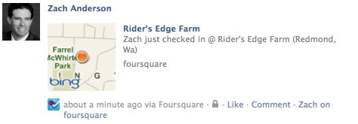

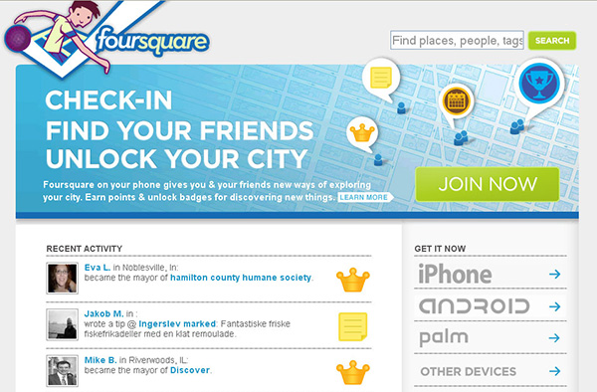
7 PROVEN STRATEGIES
5. Leveraging Foursquare
Similar to Facebook Places, Foursquare is an application that allows you to check-in to businesses that you visit. Foursquare has a game play that allows you to earn points, unlock badges, see where your friends are and more importantly become the Mayor of your business. This platform also sends out a message on both social networks…Facebook and Twitter. You are also able to see where friends are at.
You can have a special, give incentives to people that check-in and give something special to the Mayor. By encouraging people to check-in, you are creating a natural BUZZ on Facebook and Twitter.
www.foursquare.com

Slide 8
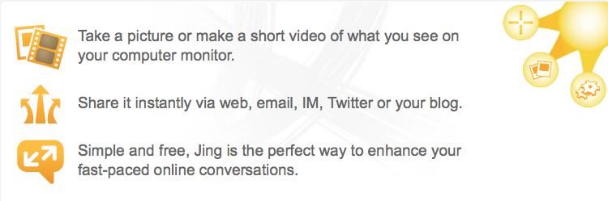
7 PROVEN STRATEGIES
6. Leverage Video To Increase Sales
Video is a very powerful way to deliver a message and it is much simpler than people think. There are many ways that you can use video in your business on a daily basis to interact with your customers. Lets say you have a business where you send quotes to clients over email and then go over them together on the phone. You could use a free service from Tech Smith called Jing. This free service allows you to capture your computer screen, upload the video on their service and share the link with your customer. In this video you are able to go over this quote in great detail avoiding any possible miscommunication and loss of sale. I personally started using this almost two years ago and have seen a drastic increase in my conversions.
Additional ways to use this free service:
  Tutorials on how to use your online products or services
  Communicate with employees on projects
  Narrate photos, plans or anything that needs explanation
  Reply to complex client questions showing examples
http://www.techsmith.com/jing/

Slide 9

7 PROVEN STRATEGIES
7. Your Own YouTube Channel
YouTube is owned by Google and is the second largest search engine next to Google. Google owns 65% of all searches on the internet. Searches on YouTube account for 25% of all searches on Google. This creates a huge opportunity for your business to create video’s on your products and services and place them on YouTube. In the previous strategy I went over how to use a free service to capture your screen. Now you just need to take those videos and post them on YouTube. You could easily record simple FAQ’s and post those on your YouTube channel as well. When doing this it is important to name your video correctly, create a great description, tag (keywords) the video appropriately and finally be sure to geo-locate your video on the map.
ADDED BONUS:
When creating your description be sure to include your business name, address, phone number and website. This must match exactly how it appears in your Google Places page.
Business Name
555 Street View
Kirkland, WA 98033
555-555-1212
http://www.businessname.com

